Slide 1
Measuring Taxes on Capital: Conceptual Explanation of the METR Methodology
Sebastian James, The World Bank Group

Slide 2
Overview
The impact of business taxes on investment is one of the most important issues in tax policy
The issue is complicated by the fact that tax regimes are very complicated, and differ substantially across jurisdictions and types of capital
Cannot just compare statutory tax rates, but rather must incorporate
Tax depreciation (write-off) rates
Special investment credits and allowances
Other taxes on business capital – property taxes, capital taxes, turnover taxes, capital transfer taxes, etc.
Tax holidays

Slide 3
Overview cont.
The key elements of the business tax system as it relates to capital investment can be summarized in a measure called the Marginal Effective Tax Rate (METR) on capital
The METR is a summary measure of the effective rate of tax imposed on the rate of return (ROR) generated by the last, or marginal, unit of capital a firm invests in

Slide 4
Conceptual Explanation of METRS
Various "stakeholders" hold an interest in firms
Debt holders
Equity holders
In order to satisfy these stakeholders, an investment must earn a rate of return (ROR) after the payment of all business taxes which is greater than or equal to the "hurdle" ROR required by these stakeholders
The hurdle ROR is the minimum ROR acceptable to these stakeholders

Slide 5
Example
Say the hurdle ROR is 10%
All capital projects which earn a ROR greater than 10%, after the payment of all business taxes, will be undertaken
The firm will invest in all projects with a ROR greater than the hurdle rate of return, investing in projects with the highest ROR first, moving down the “menu” of capital projects until the last (marginal) project undertaken earns a ROR of 10% exactly

Slide 6
Example cont.
Say the business tax system is such that in order to earn a ROR of 10% after business taxes, an investment must earn a ROR of 15% before business taxes
The METR is simply:
(15%-10%)/15% = 33.33%

Slide 7
Example cont.
The METR measures the share of the investment’s pre-tax rate of return needed to cover the taxes.
In this case 33.33% of the before-tax ROR on a marginal investment is required to cover its taxes
. . . now for more detail

Slide 8
How do firms make investment decisions?
Ignore taxes for a minute
All investments that earn a rate of return in excess of a minimum required hurdle rate of return will be undertaken
Investments that earn more than the hurdle rate of return are said to earn economic profits
The very last investment project undertaken just breaks even in the sense that it earns the hurdle rate of return exactly
This is called the marginal investment

Slide 9
I’m an economist, so I need a picture
Rate of Return
Investment schedule
Hurdle Rate of Return
Im
Investment

Slide 10
What is the hurdle rate of return?
The minimum rate of return that an investment must earn in order to just cover the cost of financing it plus economic depreciation

Slide 11
Our first equation
Denote the hurdle rate of return by Rn
Rn = Rf – π + δ
π is the rate of inflation
δ is the economic rate of depreciation (wear and tear)
R is the weighted average return to debt and equity (the cost of financing the investment)
R=βi+(1-β)ρ
i is the interest rate on debt
ρ is the required rate of return on equity
β is the proportion of the investment financed by debt

Slide 12
Example
i = ρ = .08
then it doesn’t matter what β is and R =.08
π = .04
δ = .20
Rn = .08 - .04 + .20 = .24 or 24%
All investments that earn a rate of return greater than 24% will be undertaken, those with lower rates of return will not, and the very last (marginal) investment undertaken will earn 24% exactly

Slide 13
How do taxes affect investment?
In order to earn the hurdle rate of return identified above after the payment of taxes, an investment needs to earn a higher rate of return before the payment of taxes
This is how taxes can discourage investment

Slide 14
Let’s consider a simple Corporate Income Tax (CIT)
Rn = Rf – π + δ should now be thought of as the after-tax hurdle rate of return
Thus Rn is the minimum rate of return that an investment must earn after the payment of the CIT
In order to earn an after-tax rate of return of Rn, the investment must (usually) earn a higher before-tax rate of return

Slide 15
The CIT affects the before-tax rate of return required to generate this after-tax hurdle rate of return in two ways:
Lowers the revenues generated by the investment by taxing those revenues
Lowers the cost of the investment by allowing certain deductions and allowances

Slide 16
1. Lowers revenues generated by an investment by taxing those revenues
If the CIT rate is u, in order to earn a rate of return of
Rn=(R– π + δ) after tax
Must earn a rate of return of
Rg = (Rf – π + δ) / (1-u) before tax

Slide 17
Using the previous numbers, if the CIT rate is 30% (u=.30) and given that we are ignoring deductions for a minute, then this is basically like a gross revenue (turnover) tax and the before-tax rate of return required to generate the required after-tax rate of return is:
Rg = (Rf – π + δ)/(1-u)
= .24/(1-.30)
= .343 or 34.3%

Slide 18
So, in order to earn the required after-tax hurdle rate of return of 24% an investment subject to this sort of tax on gross revenue (turnover), with no deductions, would have to earn a before-tax rate of return of 34.3%

Slide 19
What does this do to our picture?
Rate of Return
After-tax investment schedule
Rg=.343
Before-tax investment schedule
Rn=.24
Ig
Im
Investment

Slide 20
2. But a CIT also allows deductions associated with the cost of the investment
Two basic kinds of deductions:
Depreciation deductions and allowances associated with the capital expenditure
Deductions for interest payments on any debt used to finance the investment

Slide 21
Depreciation deductions and allowances
Consider a $1 capital expenditure
Initial investment allowance at the rate θ
Declining balance depreciation on the balance at the rate 𝛿

Slide 22
Flow of deductions
Year | Deduction | Undepreciated Capital Cost
1 | θ+(1-θ)𝛿 | (1-θ)(1-𝛿)
2 | 𝛿(1-θ)(1-𝛿) | (1-θ)(1-𝛿)(1-𝛿)= (1-θ)(1-𝛿)²
3 | 𝛿(1-θ)(1-𝛿)² | (1-θ)(1-𝛿)³
4 | . . . | . . .

Slide 23
In present value terms
The present discounted value of the allowance and the depreciation deductions on the $1 expenditure is:
Z = θ +(1-θ){ 𝛿 + 𝛿(1-𝛿)/(1+R)
+ 𝛿(1-𝛿)²/(1+R)² + . . .}
Z = θ + (1-θ)𝛿/(R+𝛿)

Slide 24
What does this do to Rg?
The investment allowance and depreciation deductions are deducted at the CIT rate u
This lowers the cost of the investment by uZ because it offsets the taxes on the revenues
The after-tax cost of a $1 investment expenditure is therefore $(1-uZ)
The before-tax rate of return Rg required to generate the after-tax hurdle rate of return Rn is now:
Rg = (Rf – π + δ) (1-uZ) /(1-u)

Slide 25
Two things happening to Rg = (R – π + δ) (1-uZ) /(1-u)
The taxation of the revenues generated by the investment raises the required before-tax rate of return (dividing by 1-u)
The deduction of capital costs in the form of the investment allowance and depreciation lowers the required before-tax rate of return (multiplying by 1-uZ)
Which one dominates?

Slide 26
Example
i = ρ = R = .08
π = .04
δ = .20
u = .30
θ = .50
𝛿 = .25
Z = θ + (1-θ)𝛿/(R+𝛿)
= .5+(1-.5).25/(.08+.25)
= .879
uZ = .3(.879)=.264
Rg = (Rf – π + δ)(1-uZ)/(1-u)
= (.08-.04+.2)(1-.264)/(1-.3)
= .252 or 25.2%

Slide 27
What does this mean?
Now that we’ve allowed for some deductions associated with the capital expenditure
in order to earn the after-tax required hurdle rate of return of 24%, a marginal investment must earn a before-tax rate of return of 25.2%
Compare this to the Rg of 34.3% when we didn’t allow any deductions and just taxed turnover

Slide 28
Our picture again . . .
Rate of Return
After-tax investment schedule for turnover tax
After-tax investment schedule for CIT
Rg=.343
Before-tax investment schedule
Rg’=.252
Rn=.24
Ig
Ig’
Im
Investment

Slide 29
The Marginal Effective Tax Rate (METR) on Capital
Measures the share of the before-tax rate of return that is required to pay the taxes generated by the investment
A slight complication is that it is standard to express Rg and Rn net of depreciation:
METR = {(Rg-δ) - (Rn-δ)} / {Rg-δ}
METR = {Rg - Rn} / {Rg-δ}

Slide 30
Example
Rn = .24
Rg = .252
δ = .20
METR = {Rg - Rn} / {Rg-δ}
= {.252 - .24} / {.252-.20}
= .012/.052
= .2307 or about 23%

Slide 31
What does this mean?
A METR of 23% means that taxes account for 23% of the before-tax (net of depreciation) rate of return on a marginal investment (one that just generates the required after-tax hurdle rate of return)
23% of the before-tax rate of return on a marginal investment is needed to cover its taxes

Slide 32
What about interest deductions?
Say a fraction β of the investment is financed by debt
If interest on that debt is tax deductible, the after-tax cost of financing the investment becomes:
Rf = βi (1-u) + (1-β)ρ
Replace R with Rf in the Rg equation

Slide 33
Example
β = .4
i = ρ = .08
u = .3
Then Rf = βi(1-u)+(1-β)ρ = .0704
Then Rg = (Rff – π + δ)(1-uZ)/(1-u)
= (.0704 - .04 + .20)(1-.264)/(1-.30)
= .2460 or 24.6%

Slide 34
Thus, in the presence of tax deductible debt interest, a before-tax rate of return of only 24.6% is required to earn the after-tax hurdle rate of return of 24%
Compare to 25.2% when there was no interest deduction

Slide 35
The METR in this case
Rn = .24
Rg = .246
δ = .20
METR = {Rg - Rn} / {Rg-δ}
= {.246 - .24} / {.246-.20}
= .006/.046
= .1304 or about 13%
Compare with a METR of 23% with no debt

Slide 36
METRs and Tax Policy
Can compute METRs for different types of capital, in different sectors, in different countries
Overall objective is to have a tax system with relatively low investment distortions
Differences in METRs across sectors cause distortions in investment across sectors – inter-sectoral distortions
Differences in METRs across types of capital cause distortions in investments across assets – inter-asset distortions

Slide 37
METRs and Tax Policy cont.
Overall you want a relatively low METR to encourage investment (or discourage it less)
But remember, you still need to raise tax revenue!

Slide 38
Generally, the METR is lower:
The lower is the CIT rate (u)
The higher is the Investment Allowance rate (θ)
The higher is the tax depreciation rate (𝛿) relative to the economic depreciation rate (δ)

Slide 39
Holding the tax parameters constant, the METR is lower:
The lower is the economic rate of depreciation (δ)
The higher is the share of investment financed by debt (β)
The lower is the inflation rate (π) - usually

Slide 40
Extensions
We have modeled a simple CIT system here
More generally we can incorporate:
Other turnover taxes
Implicit sales taxes on capital (eg. due to imperfect VAT crediting, import duties, etc.)
Explicit capital taxes
Property taxes
Tax holidays

Slide 41
Caveats
Don’t confuse Marginal ETR with Average ETR
AETR = Total Taxes/Total Income
METR = Taxes on marginal investment/Before-tax rate of return required on marginal investment

Slide 42
Caveats cont.
METR on capital does not incorporate taxes on other inputs
Such as payroll taxes on labour
The METR is based upon a caricature of the tax system
Measures the “big picture”
Omits nuances of the tax system

Slide 43
Caveats cont.
METR reflects the statutory provisions of the tax system
Does not incorporate important administrative and compliance issues

Slide 44
Now for some Math

Slide 45
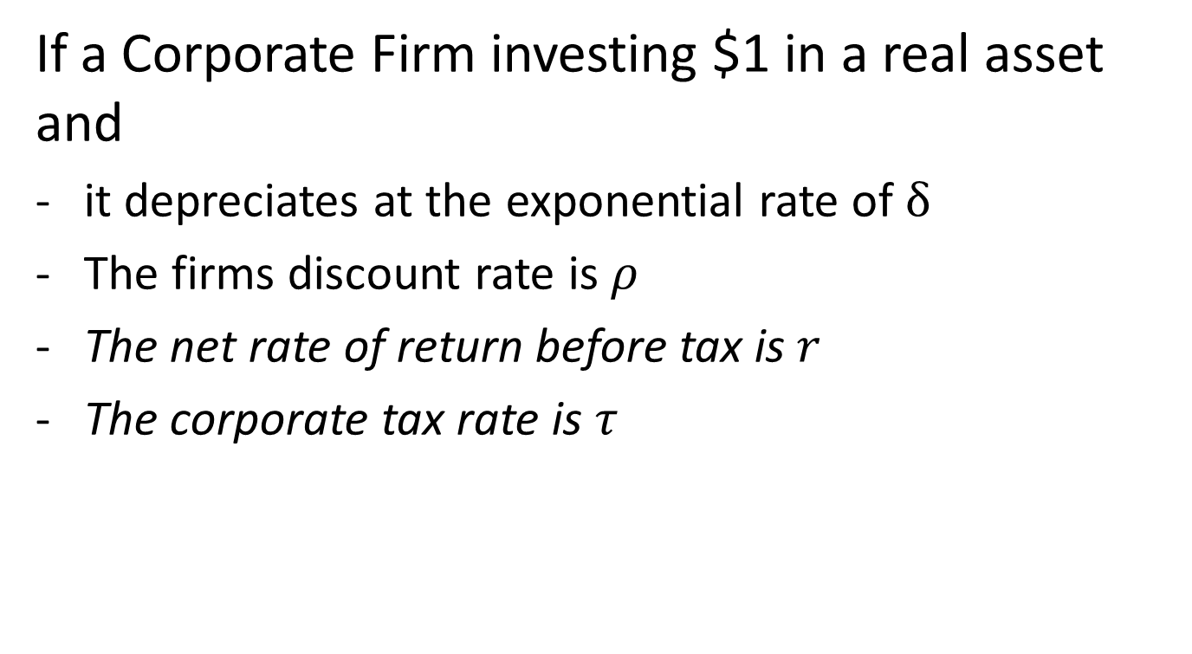
Measuring Taxes on Capital
If a Corporate Firm investing $1 in a real asset and
it depreciates at the exponential rate of $δ$
The firms discount rate is $ρ$
The net rate of return before tax is $r$
The corporate tax rate is $τ$

Slide 46
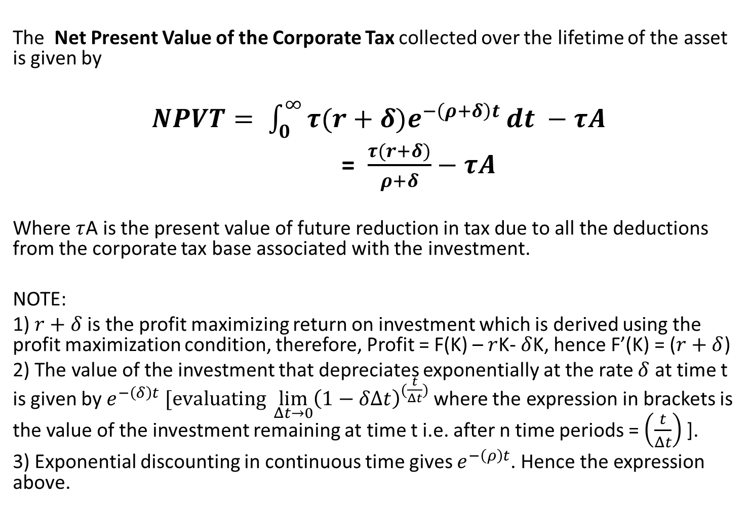
Measuring Taxes on Capital
The Net Present Value of the Corporate Tax collected over the lifetime of the asset is given by
$NPVT= \int_{0}^{∞}{τ(r+δ)e^{−\left(ρ+δ\right)t}}dt −τA$
= $\frac{τ(r+δ)}{ρ+δ}−τA$
Where $τ$A is the present value of future reduction in tax due to all the deductions from the corporate tax base associated with the investment.
NOTE:
1) $r+δ$is the profit maximizing return on investment which is derived using the profit maximization condition, therefore, Profit = F(K) – $r$K- $δ$K, hence F’(K) = ($r+δ$)
2) The value of the investment that depreciates exponentially at the rate $δ$ at time t is given by $e^{−\left(δ\right)t} [evaluating \lim_{Δt→0}{{\left(1−δΔt\right)}^{(\frac{t}{Δt})}}$where the expression in brackets is the value of the investment remaining at time t i.e. after n time periods = $\left(\frac{t}{Δt}\right)$ ].
3) Exponential discounting in continuous time gives $e^{−\left(ρ\right)t}$. Hence the expression above.

Slide 47
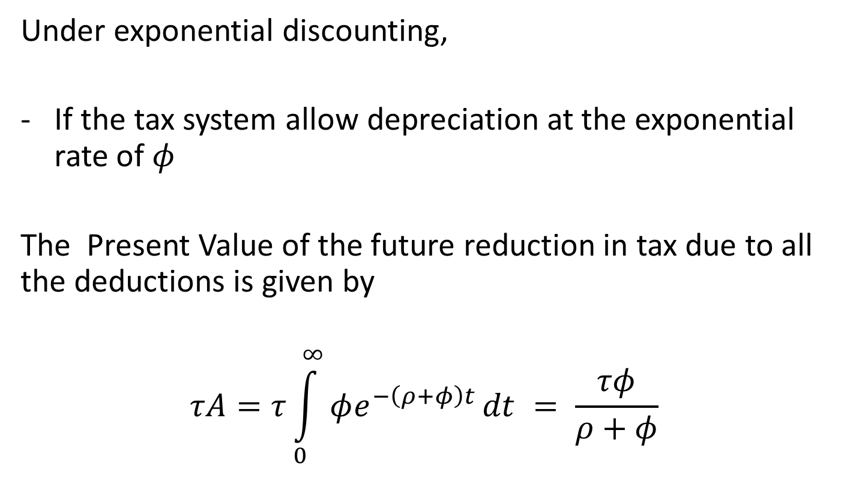
Measuring Taxes on Capital
Under exponential discounting,
If the tax system allow depreciation at the exponential rate of $φ$
The Present Value of the future reduction in tax due to all the deductions is given by
$$τA=τ\int_{0}^{∞}{φe^{−\left(ρ+φ\right)t}}dt = \frac{τφ}{ρ+φ}$$

Slide 48
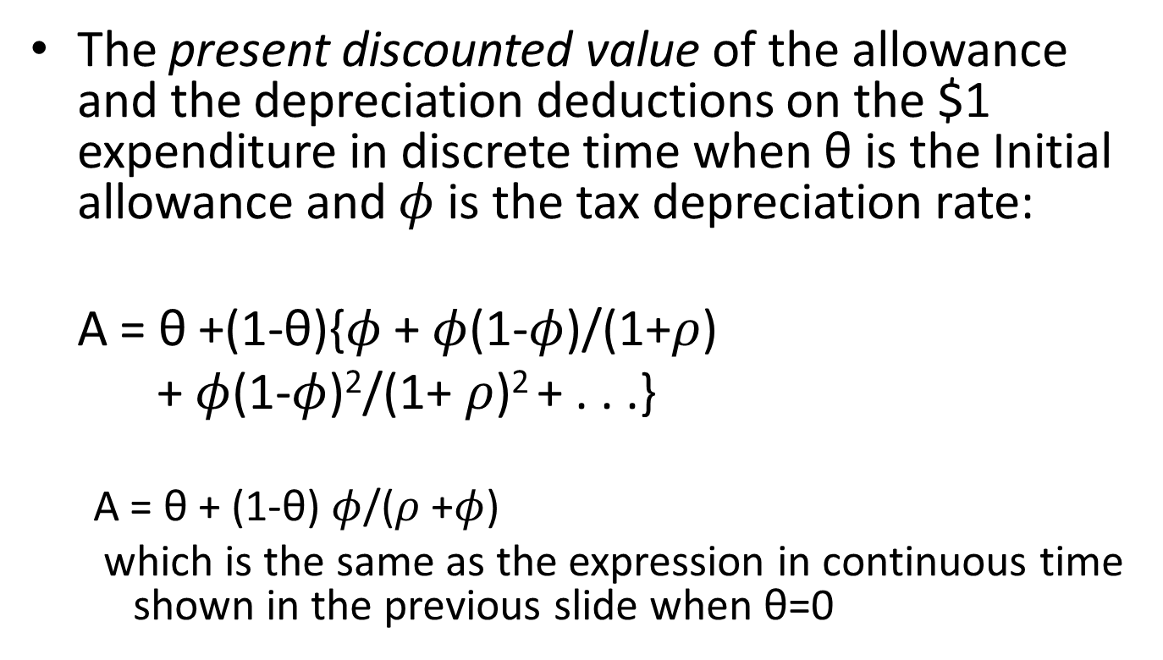
In discrete time
The present discounted value of the allowance and the depreciation deductions on the $1 expenditure in discrete time when θ is the Initial allowance and $φ$ is the tax depreciation rate:
A = θ +(1-θ){$φ$ + $φ$(1-$φ$)/(1+$ρ$)
+ $φ$(1-$φ$)²/(1+ $ρ$)² + . . .}
A = θ + (1-θ) $φ$/($ρ$+$φ$)
which is the same as the expression in continuous time shown in the previous slide when θ=0

Slide 49
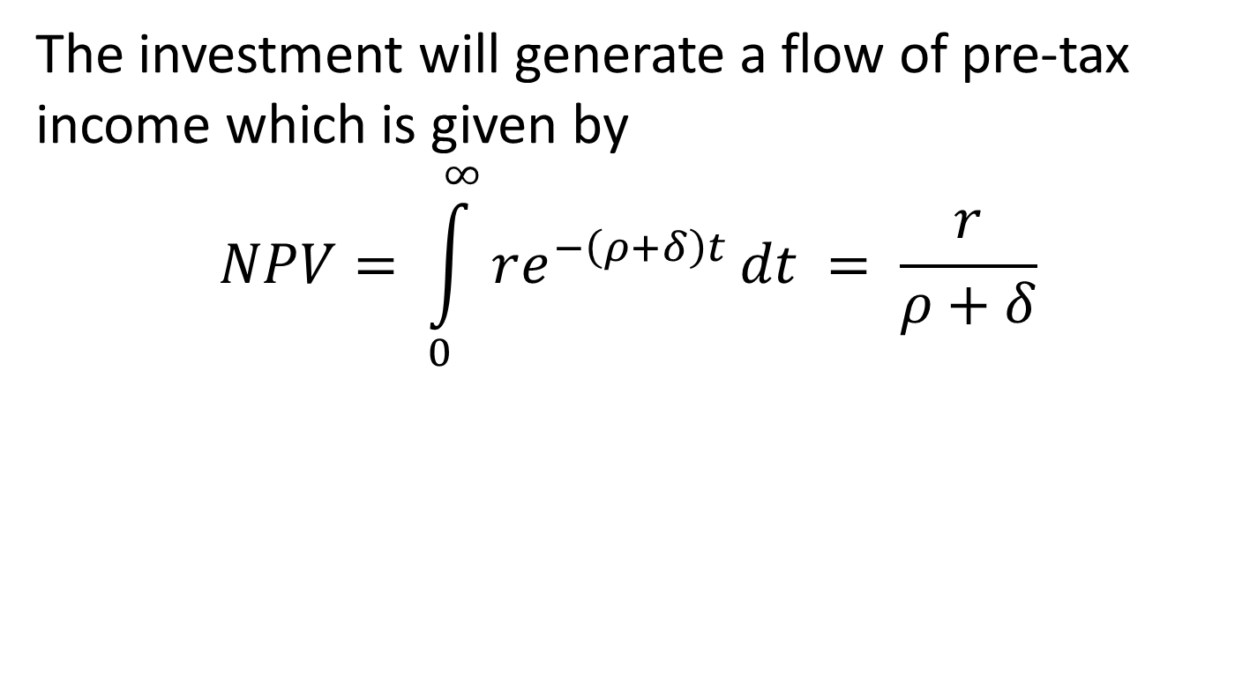
The investment will generate a flow of pre-tax income which is given by
$$NPV= \int_{0}^{∞}{re^{−\left(ρ+δ\right)t}}dt = \frac{r}{ρ+δ}$$
It is $r+δ$ but $δ$ is used to fix the loss of value due to depreciation, so investor gets only $r$

Slide 50
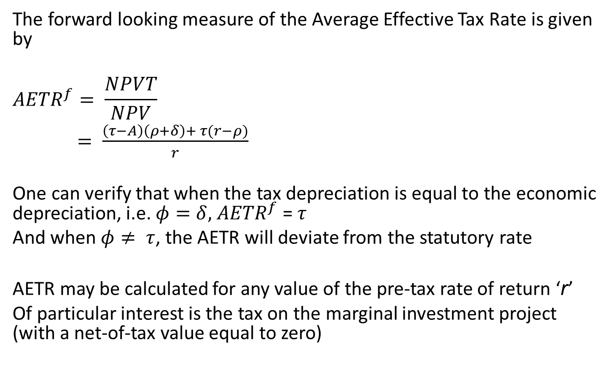
AETR
The forward looking measure of the Average Effective Tax Rate is given by
$${AETR}^{f}= \frac{NPVT}{NPV}$$
$= \frac{\left(τ−A\right)\left(ρ+δ\right)+ τ(r−ρ)}{r}$
One can verify that when the tax depreciation is equal to the economic depreciation, i.e. $φ=δ, { AETR}^{f}$ = $τ$
And when $φ≠ τ$, the AETR will deviate from the statutory rate
AETR may be calculated for any value of the pre-tax rate of return ‘r’
Of particular interest is the tax on the marginal investment project (with a net-of-tax value equal to zero)

Slide 51
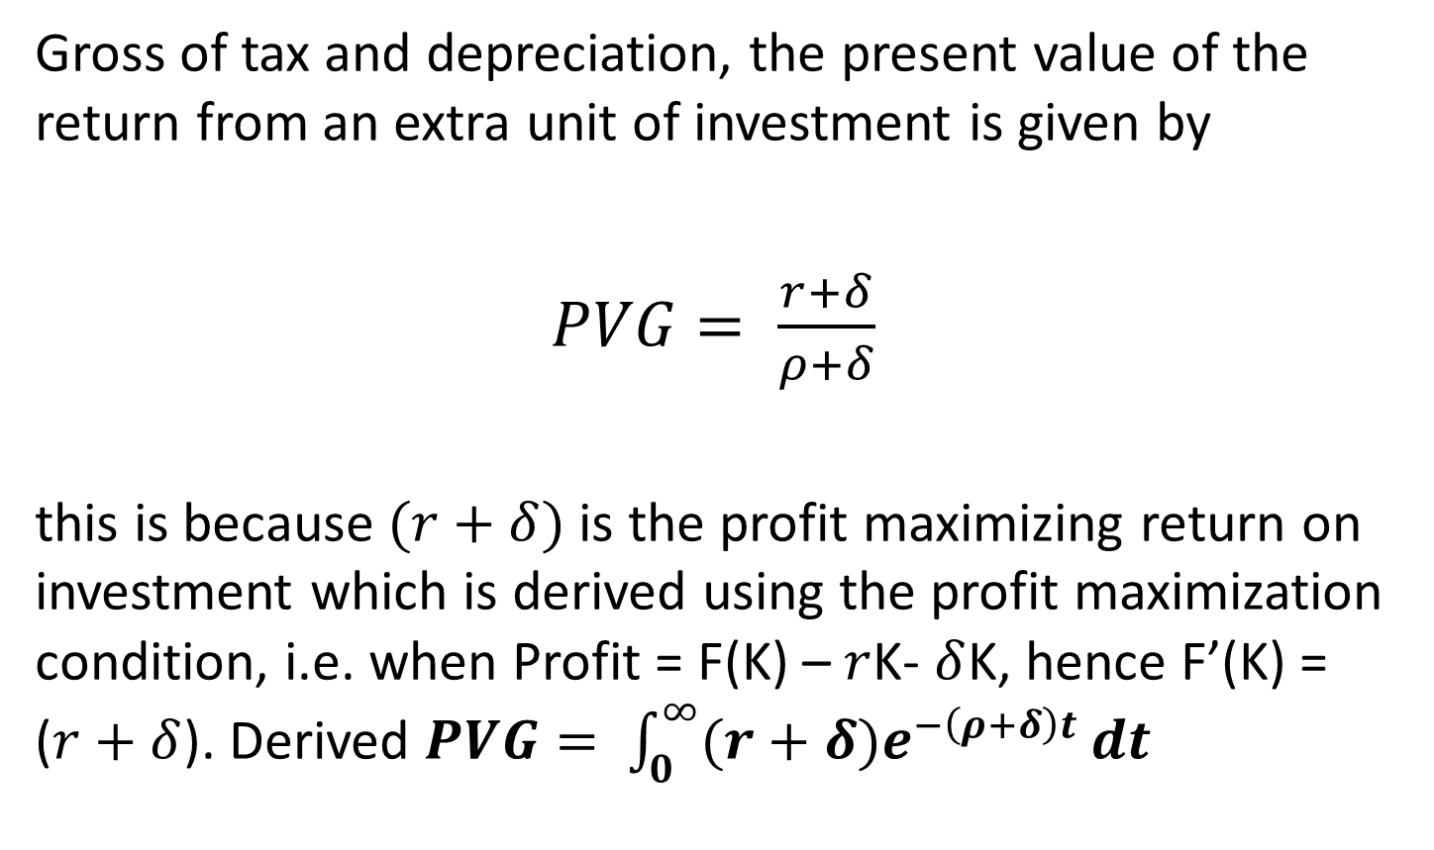
Marginal Effective Tax Rate (METR)
Gross of tax and depreciation, the present value of the return from an extra unit of investment is given by
$PVG= \frac{r+δ}{ρ+δ}$
this is because$(r+δ)$is the profit maximizing return on investment which is derived using the profit maximization condition, i.e. when Profit = F(K) – $r$K- $δ$K, hence F’(K) = ($r+δ$). Derived $PVG= \int_{0}^{∞}{(r+δ)e^{−\left(ρ+δ\right)t}}dt$

Slide 52
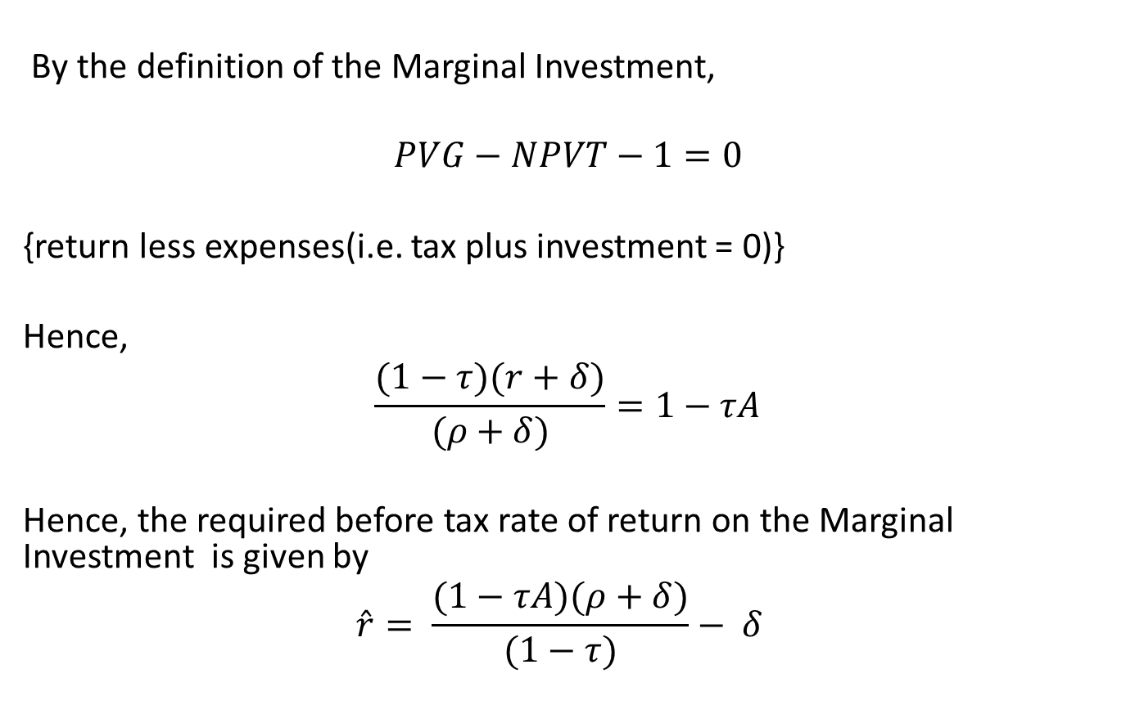
Marginal Effective Tax Rate (METR)
By the definition of the Marginal Investment,
$$PVG−NPVT−1=0$$
{return less expenses(i.e. tax plus investment = 0)}
Hence,
$$\frac{(1−τ)(r+δ)}{(ρ+δ)}=1−τA$$
Hence, the required before tax rate of return on the Marginal Investment is given by
$$\hat{r}= \frac{(1−τA)(ρ+δ)}{(1−τ)}− δ$$

Slide 53
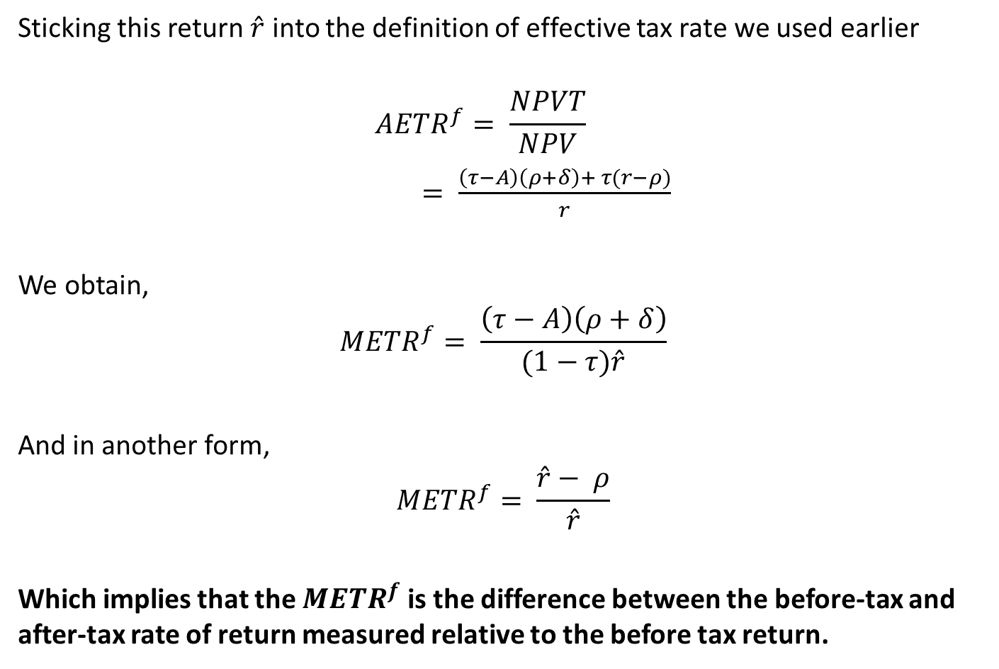
METR
Sticking this return $\hat{r}$ into the definition of effective tax rate we used earlier
$${AETR}^{f}= \frac{NPVT}{NPV}$$
$= \frac{\left(τ−A\right)\left(ρ+δ\right)+ τ(r−ρ)}{r}$
We obtain,
$${METR}^{f}= \frac{\left(τ−A\right)\left(ρ+δ\right)}{(1−τ)\hat{r}}$$
And in another form,
$${METR}^{f}= \frac{\hat{r}− ρ}{\hat{r}}$$
Which implies that the ${METR}^{f}$ is the difference between the before-tax and after-tax rate of return measured relative to the before tax return.

Slide 54
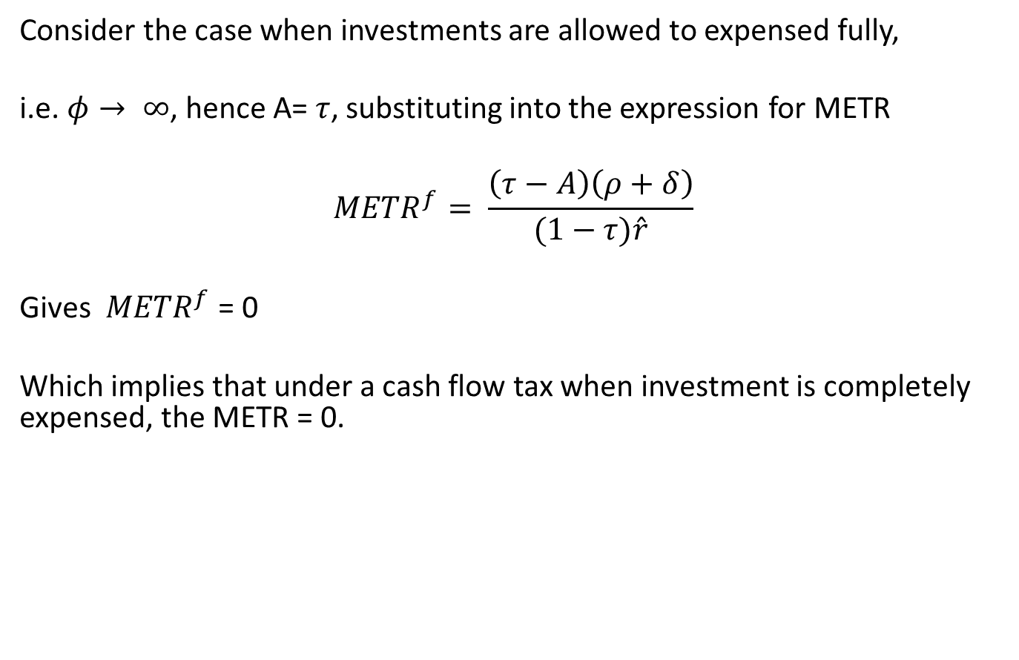
METR
Consider the case when investments are allowed to expensed fully,
i.e. $φ→ ∞$, hence A= $τ$, substituting into the expression for METR
$${METR}^{f}= \frac{\left(τ−A\right)\left(ρ+δ\right)}{(1−τ)\hat{r}}$$
Gives ${METR}^{f}$ = 0
Which implies that under a cash flow tax when investment is completely expensed, the METR = 0.

Slide 55
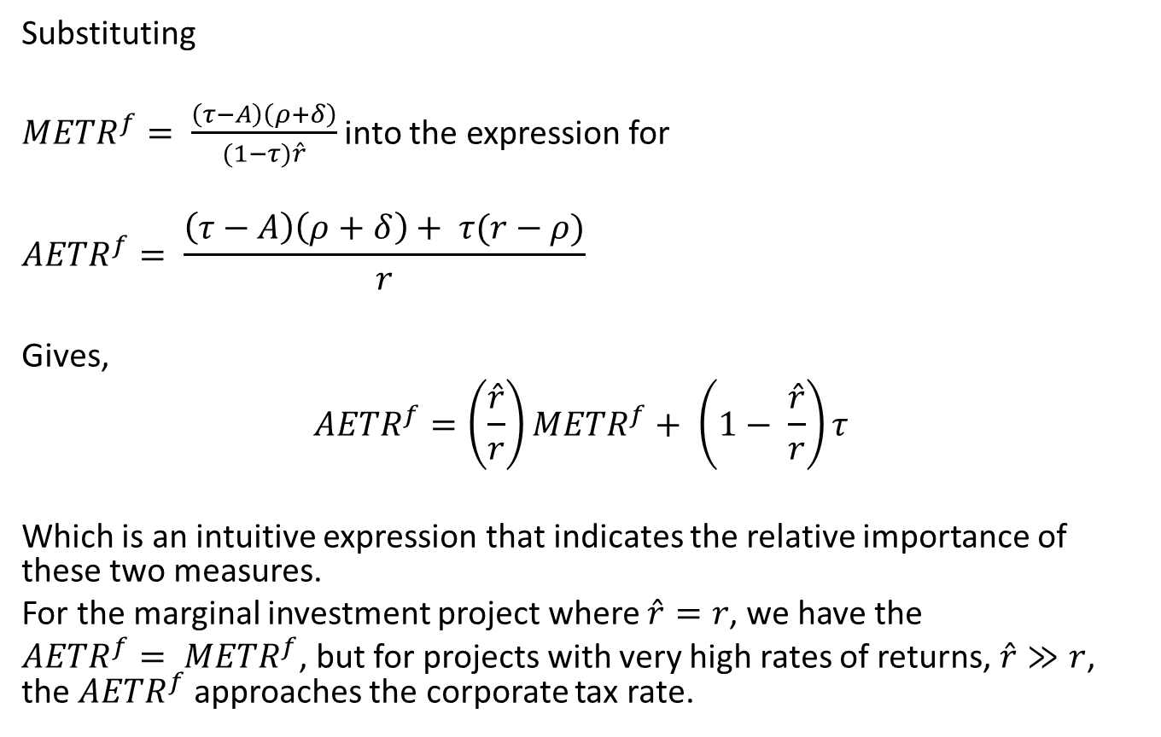
AETR vs. METR
Substituting
${METR}^{f}= \frac{\left(τ−A\right)\left(ρ+δ\right)}{(1−τ)\hat{r}}$ into the expression for
$${AETR}^{f}= \frac{\left(τ−A\right)\left(ρ+δ\right)+ τ(r−ρ)}{r}$$
Gives,
$${AETR}^{f}=\left(\frac{\hat{r}}{r}\right){METR}^{f}+ \left(1− \frac{\hat{r}}{r}\right)τ$$
Which is an intuitive expression that indicates the relative importance of these two measures.
For the marginal investment project where $\hat{r}=r$, we have the
${AETR}^{f}= {METR}^{f}$, but for projects with very high rates of returns, $\hat{r}≫r$, the ${AETR}^{f}$ approaches the corporate tax rate.

